Slide 1

Linear Integrated Circuits EE-411 L1
Dr. Syed Arsalan Jawed
Associate Professor of Practice
Office Hours : W-301, Tuesday/Thursday : 1600-1700
September 02-04, 2025
H-505
!پھربرق فروزاں ہےسر وادی سینا ، اۓدیدہ بینا
The flame of illumination set ablaze…. O’ the beholder of sight!

Slide 2
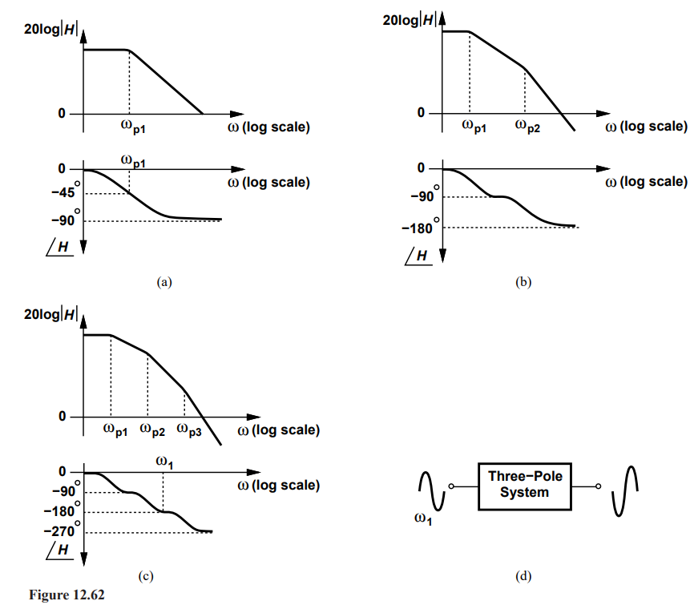

Stability in Feedback System

Slide 3
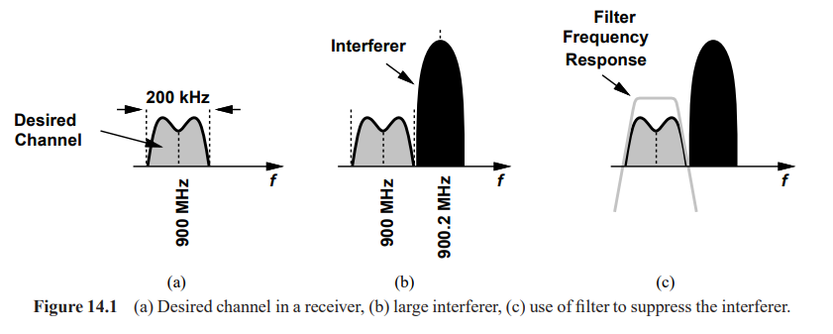
Chapter 14 : Analog Filters (skipping Chapter 13 for now)

Slide 4
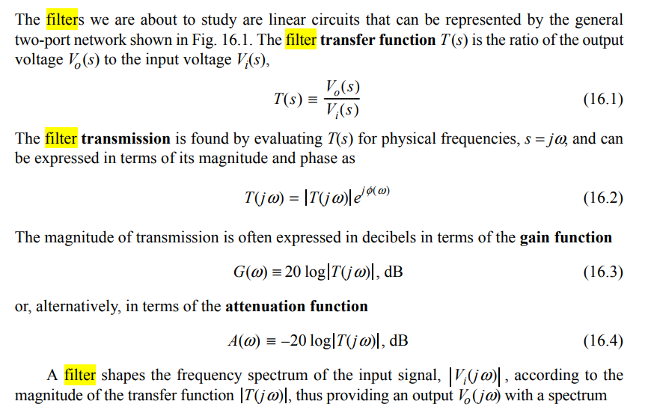
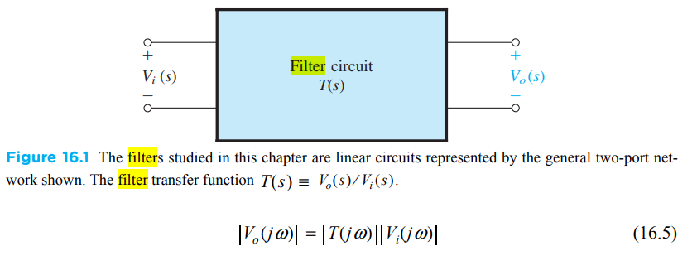

Slide 5
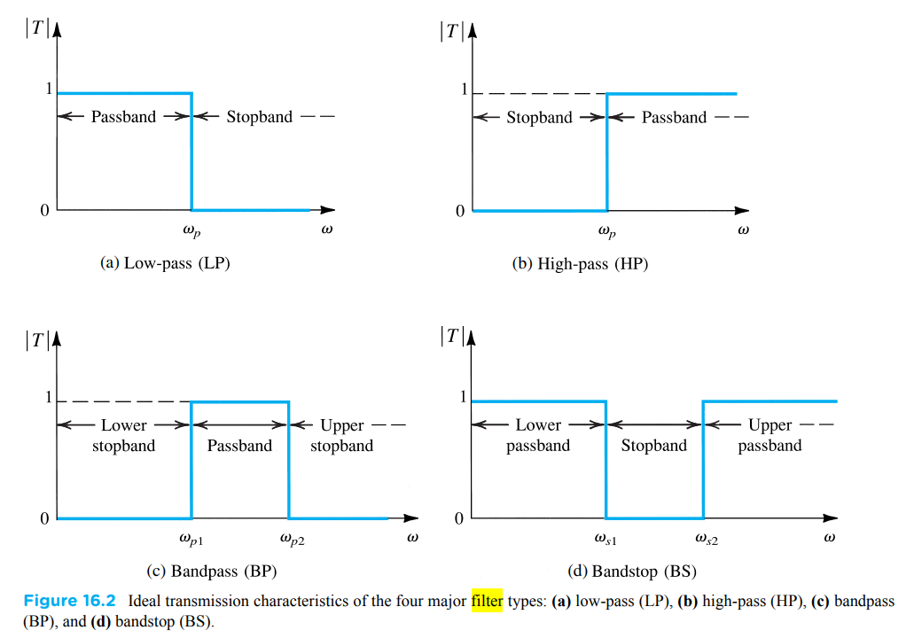
Filter Types

Slide 6
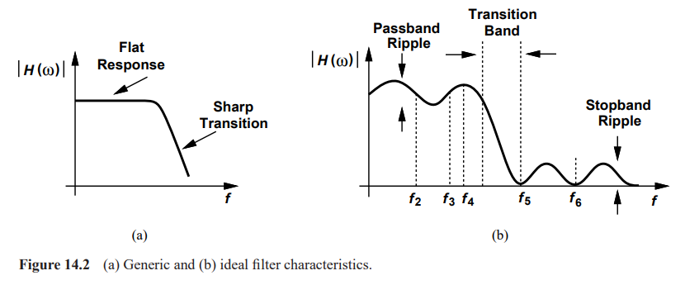
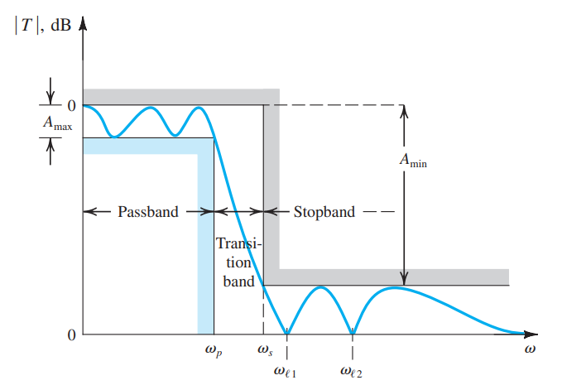
Filter Characteristics/Specifications

Slide 7
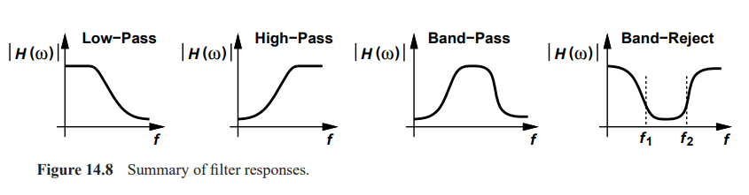
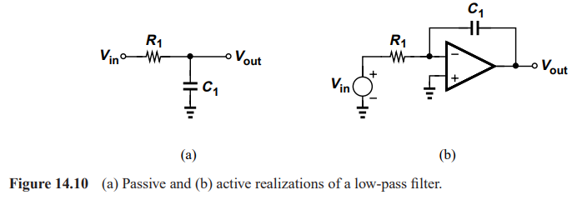
Classification of Filters

Slide 8
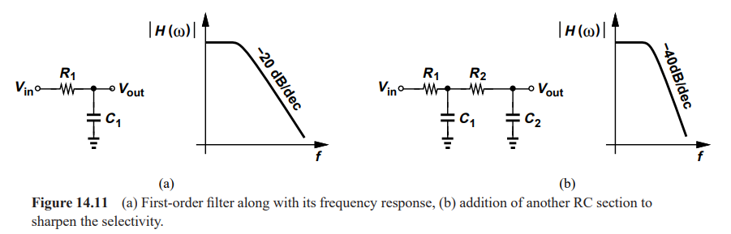

Filter Transfer Function

Slide 9
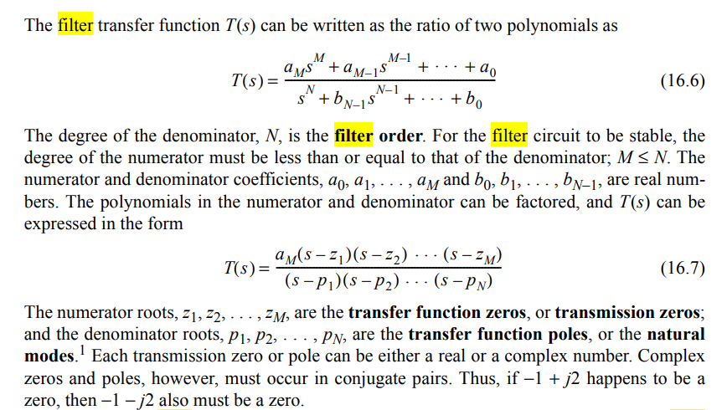

Slide 10
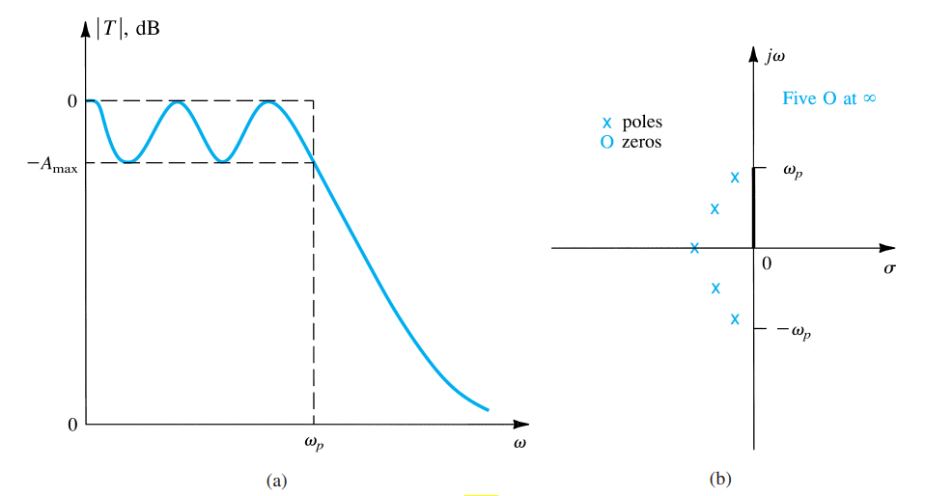
Poles, Zeros and S-Plane

Slide 11
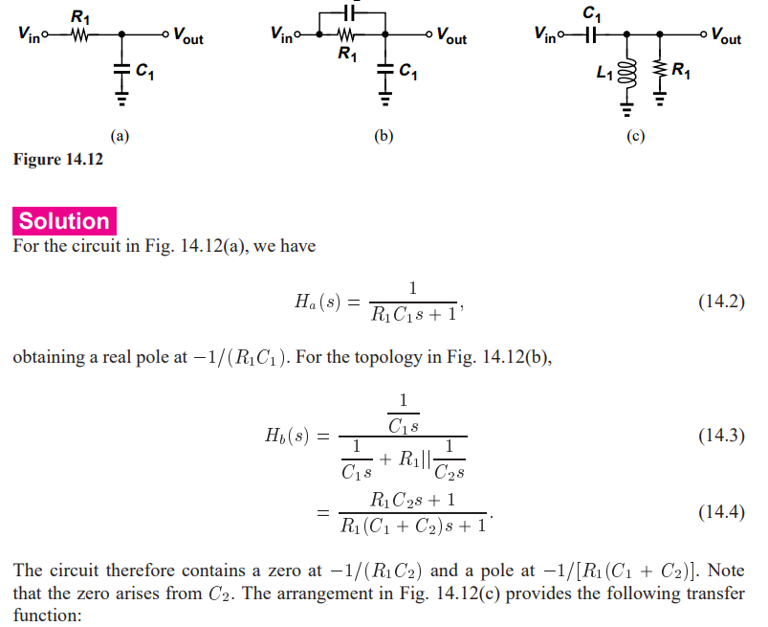
Example 14.4

Slide 12
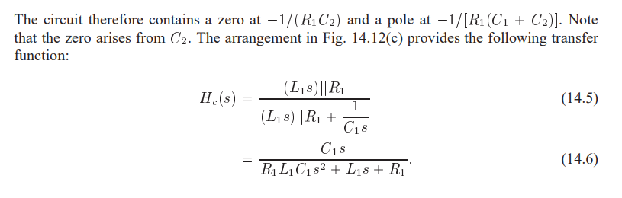
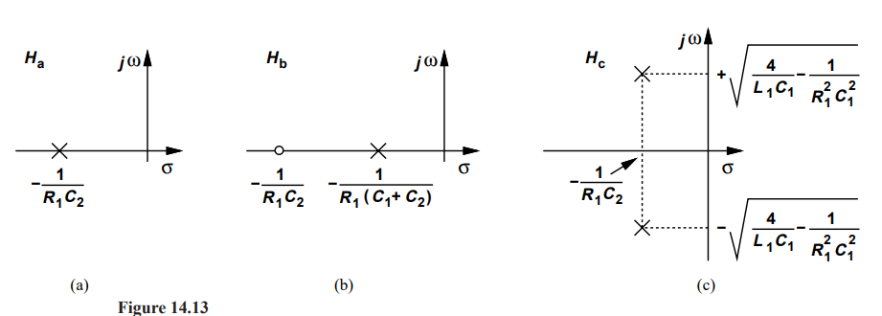

Slide 13
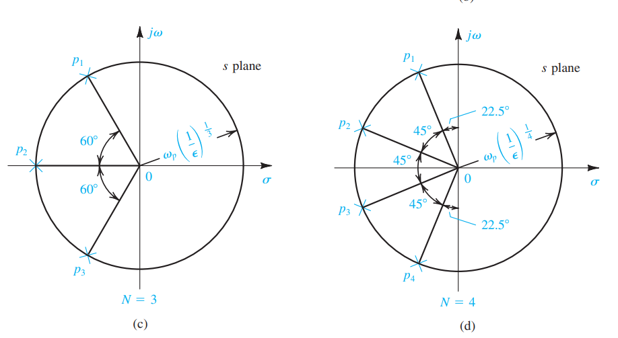
Butterworth and Chebychev Filters
Butterworth : Equi placement of pole – maximum flat response in passband, slow transition

Slide 14
Chebychev : Self Study

